Slide 1
Monetary Vs. fiscal Policy

Slide 2
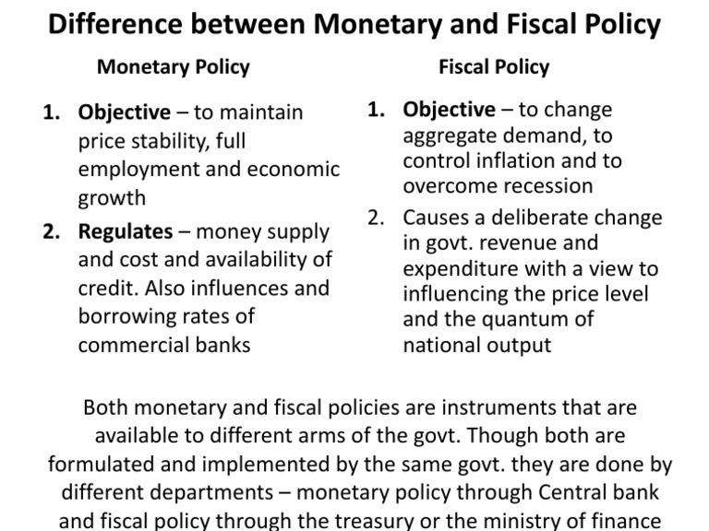

Slide 3
Monetary policy
Monetary policy is the branch of economic policy which manipulates the money supply in society to regulate the aggregate market and manage the economy.
Monetary base
The monetary base (or M0) is the total amount of a currency that is either in general circulation in the hands of the public or in the form of commercial bank deposits held in the central bank's reserves.
Eg: Narodowy Bank Polski the central bank of Poland

Slide 4
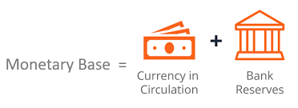
Monetary Base

Slide 5
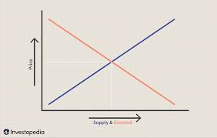
Market

Slide 6
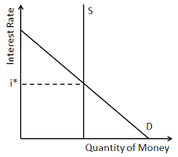

Slide 7
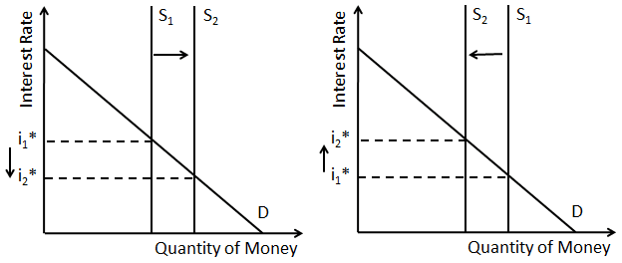
Increase/ Decrease in money supply

Slide 8
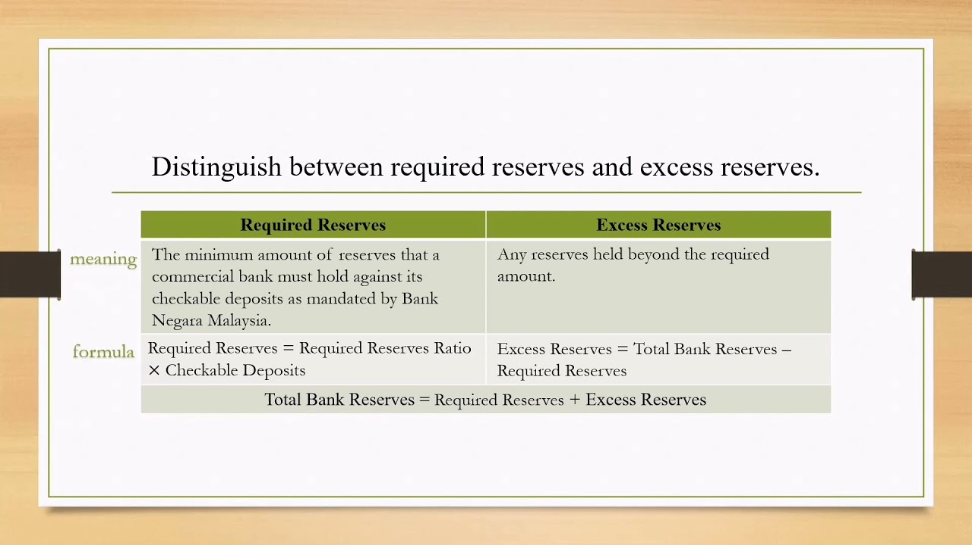
Two kinds of reserves

Slide 9
3 Monetary policy tools
1) Open market Operation
Open market operations (OMO) refers to the central bank practice of buying and selling securities, along with other securities, on the open market in order to regulate the supply of money that is on reserve in banks. The central bank purchases Treasury securities to increase the supply of money and sells them to reduce long-term interest rates.
The objective of OMOs is to adjust the level of reserve balances to manipulate the short-term interest rates and that affect other interest rates.

Slide 10
Buying securities adds money to the system, making loans easier to obtain and interest rates decline.
Selling securities from the central bank's balance sheet removes money from the system, making loans more expensive and increasing rates.

Slide 11
2) Discount Rate
Discount rate, also called rediscount rate, or bank rate, interest rate charged by a central bank for loans of reserve funds to commercial banks and other financial intermediaries.
The discount rate serves as an important indicator of the condition of credit in an economy. Because raising or lowering the discount rate alters the banks’ borrowing costs and hence the rates that they charge on loans, adjustment of the discount rate is considered a tool to combat recession or inflation.

Slide 12
The reserve ratio
Also known as Cash Reserve Ratio, it is the percentage of deposits which commercial banks are required to keep as cash according to the directions of the central bank.
The reserve ratio is an important tool of the monetary policy of an economy and plays an essential role in regulating the money supply. When the central bank wants to increase the money supply in the economy, it lowers the reserve ratio. As a result, commercial banks have higher funds to disburse as loans, thereby increasing the money supply in an economy. On the other hand, for controlling inflation, the CRR is generally increased, thereby decreasing the lending power of banks, which in turn reduces the money supply in an economy

Slide 13
https://www.youtube.com/watch?v=Ug_q97QKDjk
https://www.youtube.com/watch?v=AkMsMDk_brU

Slide 14
Fiscal Policy
Fiscal policy is the use of taxation and government spending to regulate the aggregate market and manage the economy.
Objective – To close recessionary gaps or close an inflationary gap
>>>Money coming in
>>>Money going out

Slide 15
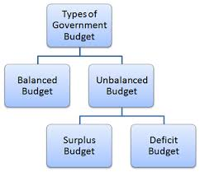
Budget
Budget is a plan for how much money will be
A) Received as income
B) Paid out as expenses.

Slide 16

Budget Plan
The budget plan includes how much the government will receive as taxes.
The government set tax rates and other kinds of tax policy.

Slide 17
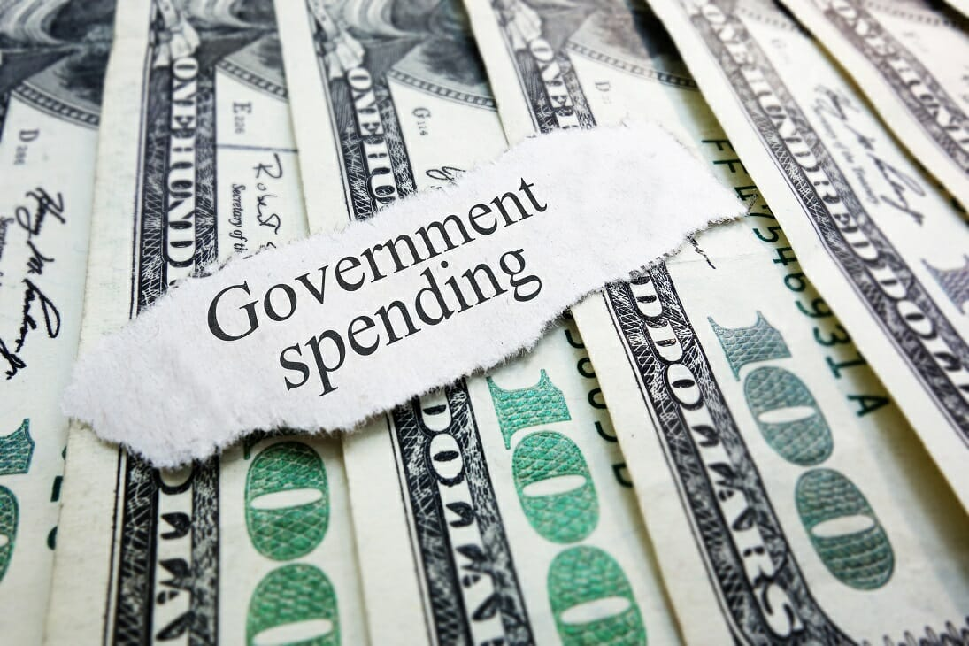
Budget plan
Government spending refers to money spent by the public sector on the acquisition of goods and provision of services such as education, healthcare, social protection, and defence.
In national income accounting, when the government acquires goods and services for current use to directly satisfy the individual or collective needs and requirements of the community, it is classified as government final consumption spending.
When the government acquires goods and services for future use, it is classified as government investment. This includes public consumption and public investment, and transfer payments consisting of income transfers

Slide 18
Purposes of Government Spending
To supply goods and services that are not supplied by the private sector, such as defence, roads, and bridges; merit goods such as hospitals and schools, and welfare payments and benefits including unemployment and disability benefits.
To achieve improvements in the supply-side of the macro-economy, such as spending on education and training to improve labour productivity.
To provide subsidies to industries that may need financial support for either their operation or expansion. The private sector is not able to meet such financial requirements and, hence, the public sector plays a crucial part in lending necessary support. For example, transport infrastructure projects do not attract private finance unless the government provides expenditures for the industry.
To help redistribute income and promote social welfare.

Slide 19
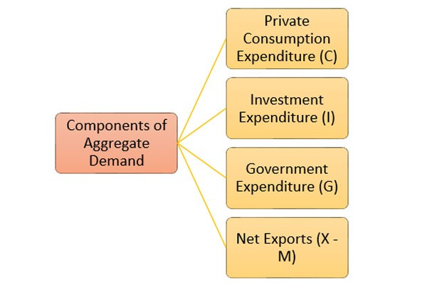

Slide 20
Three situation
Balanced budget – Is a situation where the income is equal to spending G = Taxes
Budget surplus- The excess of central government’s tax receipts over its spending. G < Taxes
Budget deficit- The excess of central government’s spending over its receipts. G > Taxes

Slide 21
Increase in government spending
G > Taxes
Budget deficit
G is one of the component of expenditure
Total Expenditure = C + I + G + (X – M)
G goes up then TE will also go up

Slide 22
Decrease in government spending
G < Taxes
Budget surplus
G is one of the component of expenditure
Total Expenditure = C + I + G + (X – M)
G goes down then TE will also go down

Slide 23
Increase in taxation
G < Taxes
Budget surplus
When taxes affects consumption, people will have less amount and thus, will spend less
Increase in tax > decrease in consumption
So, Decrease in consumption will lead to a decrease in TE.

Slide 24
Decrease in taxation
G > Taxes
Budget deficit
When taxes are less then consumption of people will increase and thus, will spend more
decrease in tax > increase in consumption
So, an increase in consumption will lead to an increase in TE.

Slide 25
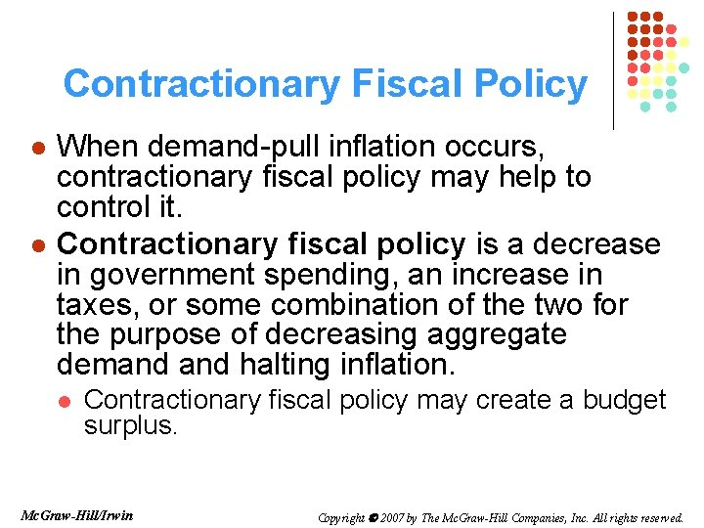
Budget surplus – Contractionary fiscal policy

Slide 26
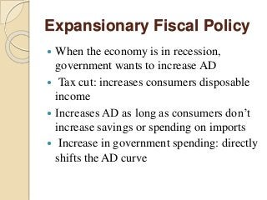
Budget deficit- Expansionary fiscal policy

Slide 27
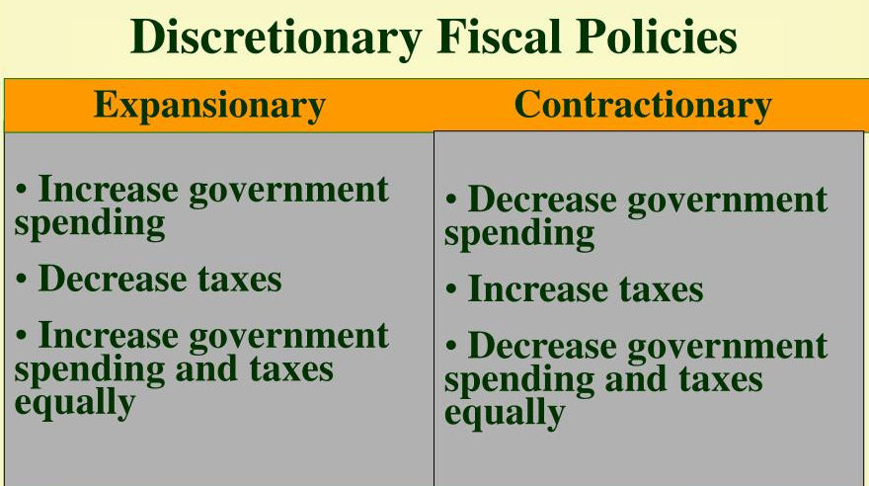

Slide 28
https://www.youtube.com/watch?v=b0SW3BgwL14
https://www.youtube.com/watch?v=b0SW3BgwL14

